Slide 1
iRep Configuration
LEVEL – PL3
20-07-2023

Slide 2
About the Author
Created By: | Prashant, Sourav Bhattacharya, Supriyo Saha
Credential Information: | Consultant CRM, Sr. Consultant CRM – EAS Salesforce
Version and Date: | V 0.9 :20-July-2023, V1.0: July-2023:Updated with Lightning UI
Modified By: | Sneha Kate

Slide 3
Recap…
In the previous Module – Reports and Dashboards, you learnt to ...
  Build reports and dashboards so that you could monitor and analyze your business data
  Explain the difference between a Report, Dashboard and Report Type
  Identify the limitations of VEEVA Reports and Dashboards
And now ...

Slide 4

Do You Know
Sales reps armed with an iPad can collect digital signatures for samples thanks to iRep, a physician detailing application
The VEEVA CRM application Offline Version is called as iRep that is used on iPad
Signing for samples on the iPad “is one of the standard functions” of iRep, and is a “validated part of the application”
In addition to sampling, iRep includes a content viewer for e-detail materials, including interactive presentations and video content
Intouch Solutions, an interactive pharma marketing shop, is a partner and content provider for iRep

Slide 5

Objectives
After completing this chapter, you will learn to:
  Define What is iRep
  Install iRep
  Navigate through iRep UI
  Configure iRep
  Define & Configure iRep CLM

Slide 6

Overview
VEEVA CRM has following two versions
  VEEVA CRM Online
  VEEVA CRM Offline
Offline version is known as iRep
iRep runs on iPad and works offline. It means Sales Representative can do call recording even if they DONT have internet connection
Once Sales Rep connect their iPad with Wi-Fi/Internet offline recorded data on iRep gets uploaded over VEEVA Server

Slide 7
iRep Configuration
What is iRep
20-07-2023

Slide 8
What is iRep
iRep is an integrated CRM and CLM application designed for the iPad
Leverages the same configuration as VEEVA CRM Online
Uses a local encrypted SQLite database
Integrates with VEEVA CRM online
Achieves full CRM capabilities on the iPad

Slide 9
iRep Configuration
Installing iRep
20-07-2023

Slide 10
Installing iRep 1
Installing iRep involves the following steps
Login to VEEVA Online using Safari from the iPad
Install iRep through link on homepage
Follow the installation instructions
  Install provisioning profile
  Then install VEEVA iRep

Slide 11
Installing iRep 2
Two main components are installed on the iPad:
  Provisioning profile
    Contains the digital signature of the iRep and allows the iPad to install it
    Installed only once
  iRep SQLite local database

Slide 12
iRep Configuration
Navigating iRep UI
20-07-2023

Slide 13
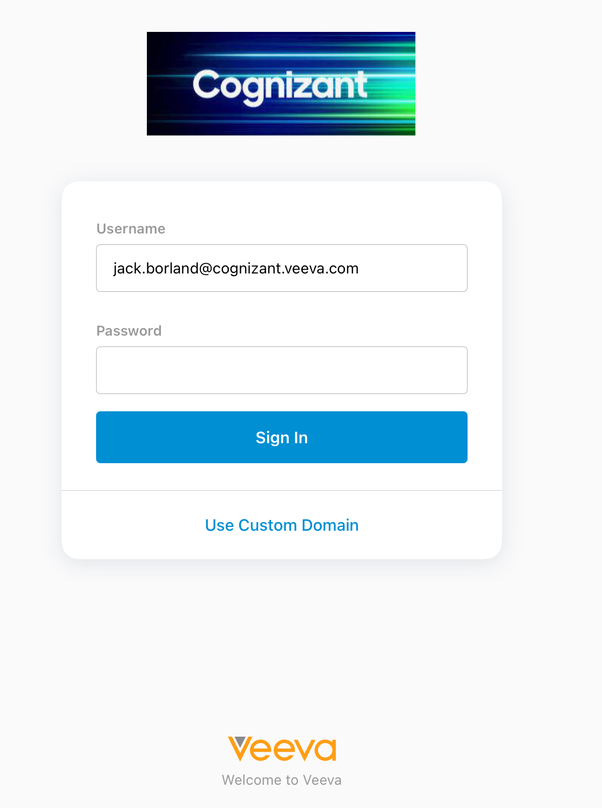
Initial Login and Sync
Tap the iRep app on the iPad Home Screen
User Name and Password are the same as when logging into VEEVA Online
iRep can store multiple user logins and databases
First synch may take 10 to 15 minutes as per the size of database

Slide 14
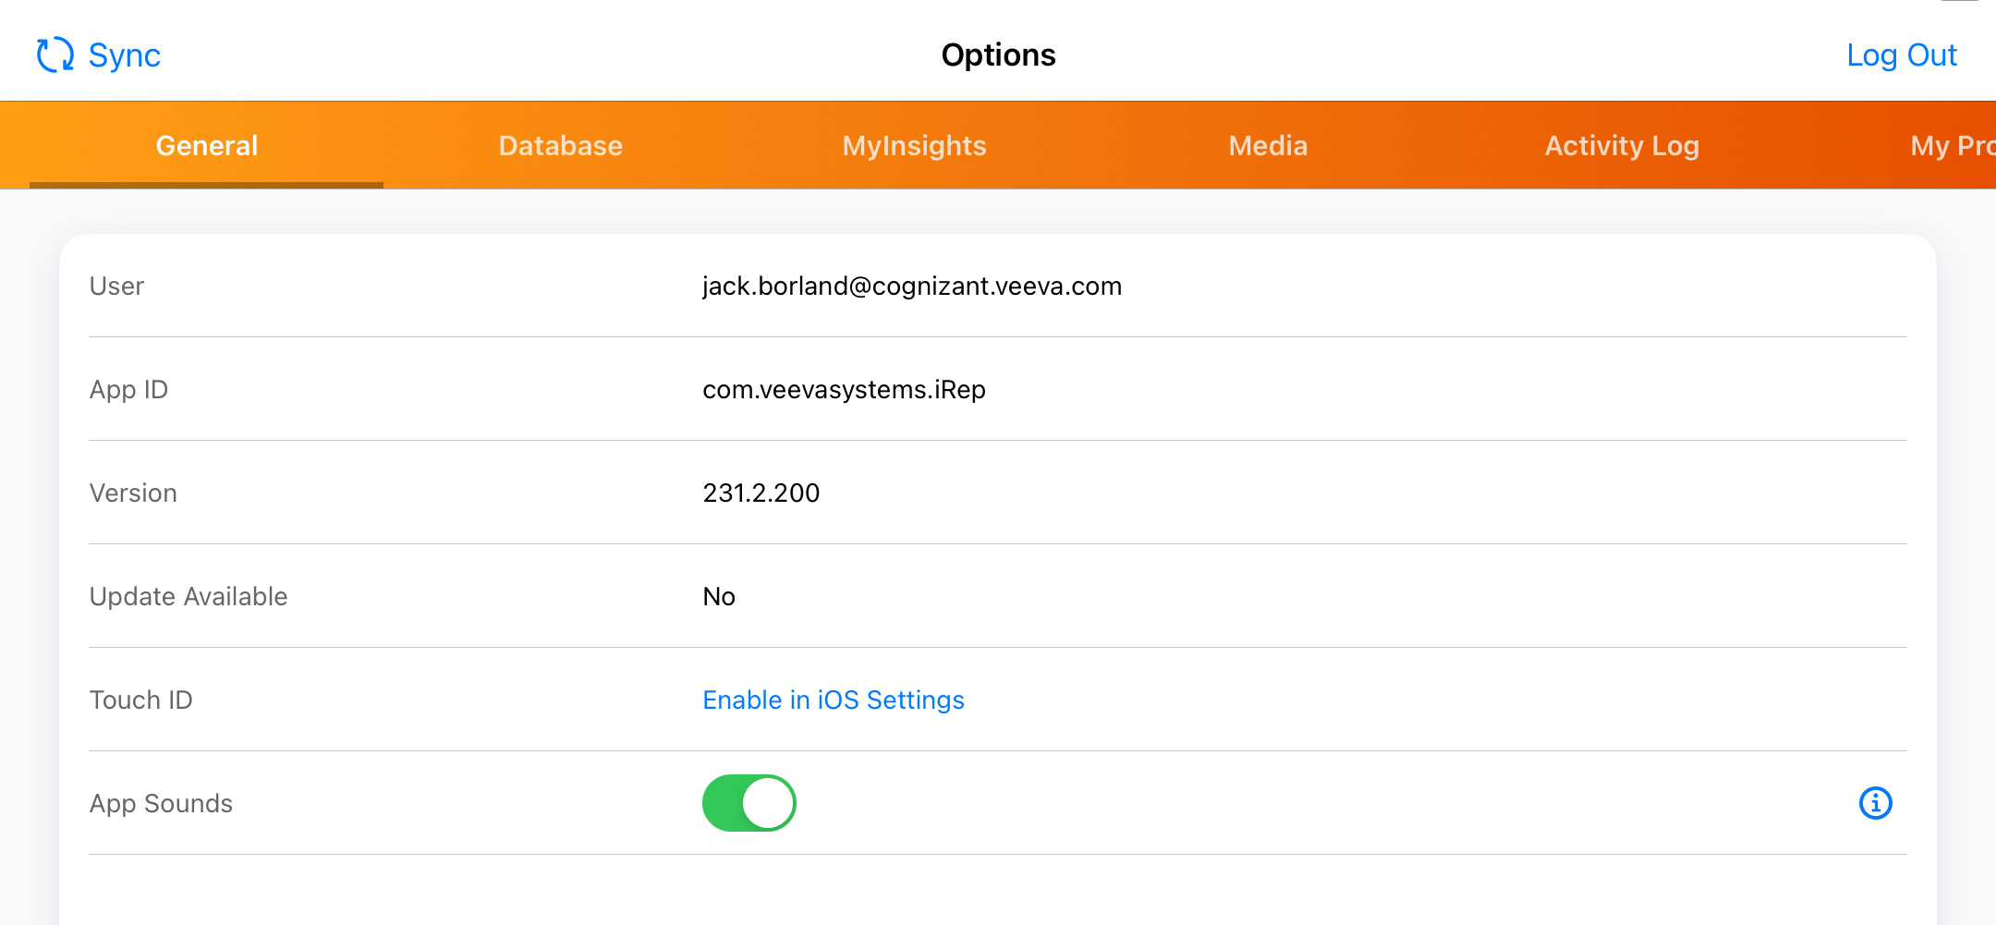
Update and Logout
Users should keep iRep updated to use latest functionality
  From the General page click Update Now if one is available
If using multiple logins
  Click the Log Out button to switch users

Slide 15
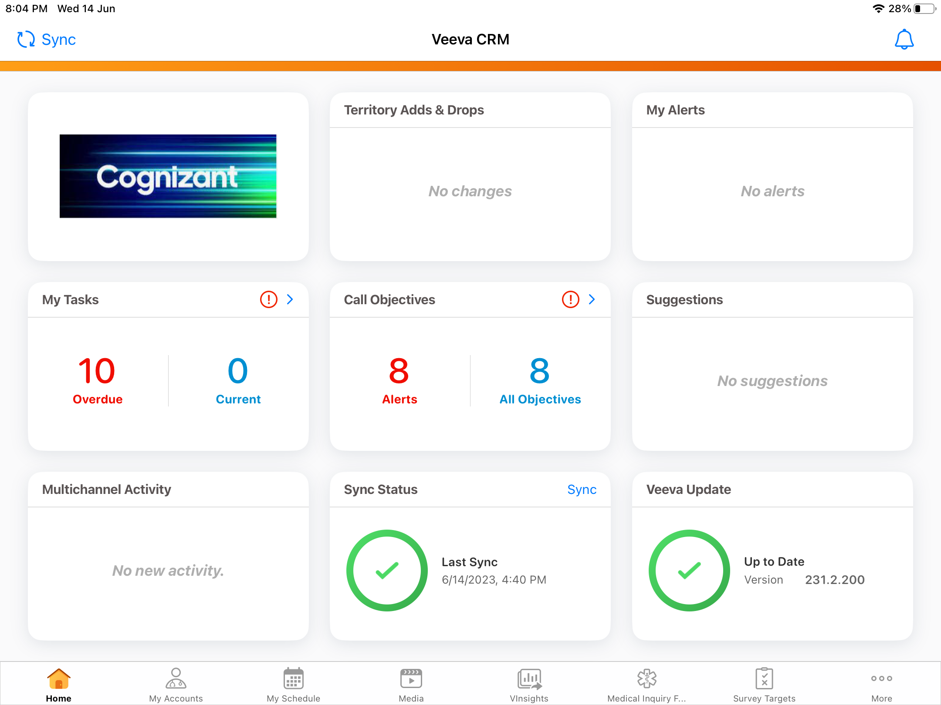
iRep Home Screen
  First Page displayed after login

Slide 16
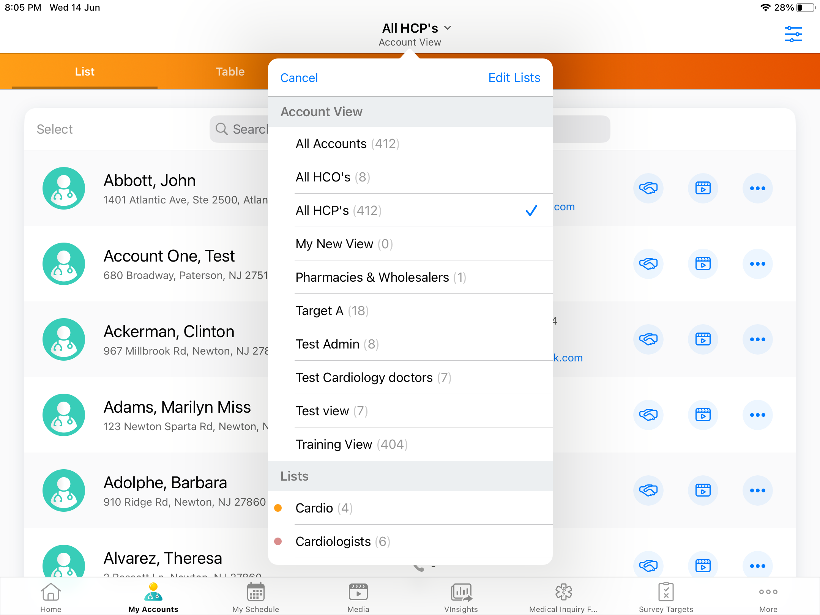
My Accounts
Lists every account the user can view
Displays the account name and primary address or first address if primary is not defined
Icons reflect record type of the account
Users can scroll or search for accounts
Tap an account to launch its detail page

Slide 17
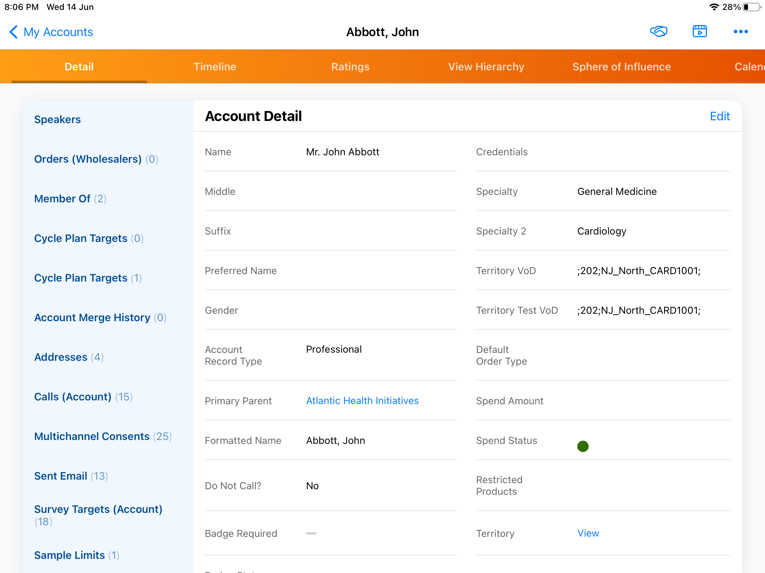
My Accounts
Left side contains action buttons and Related Lists
- Controlled by online application
Right side contains sections and fields controlled by account page layout

Slide 18
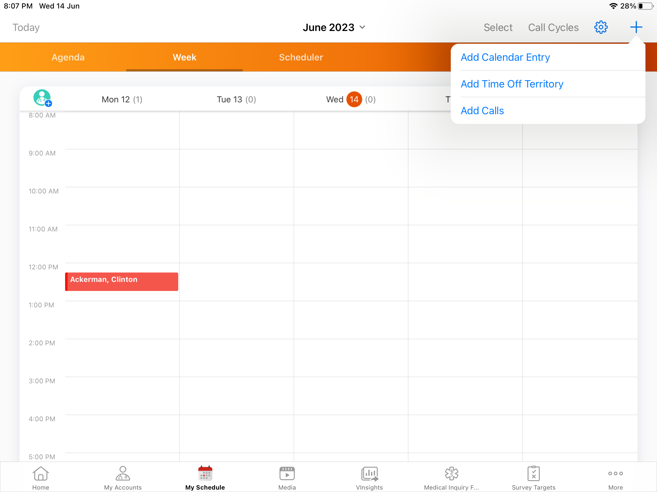
My Accounts
Managers can view their employees’ schedule
Users can create:
New Call
TOT
Calendar Events

Slide 19
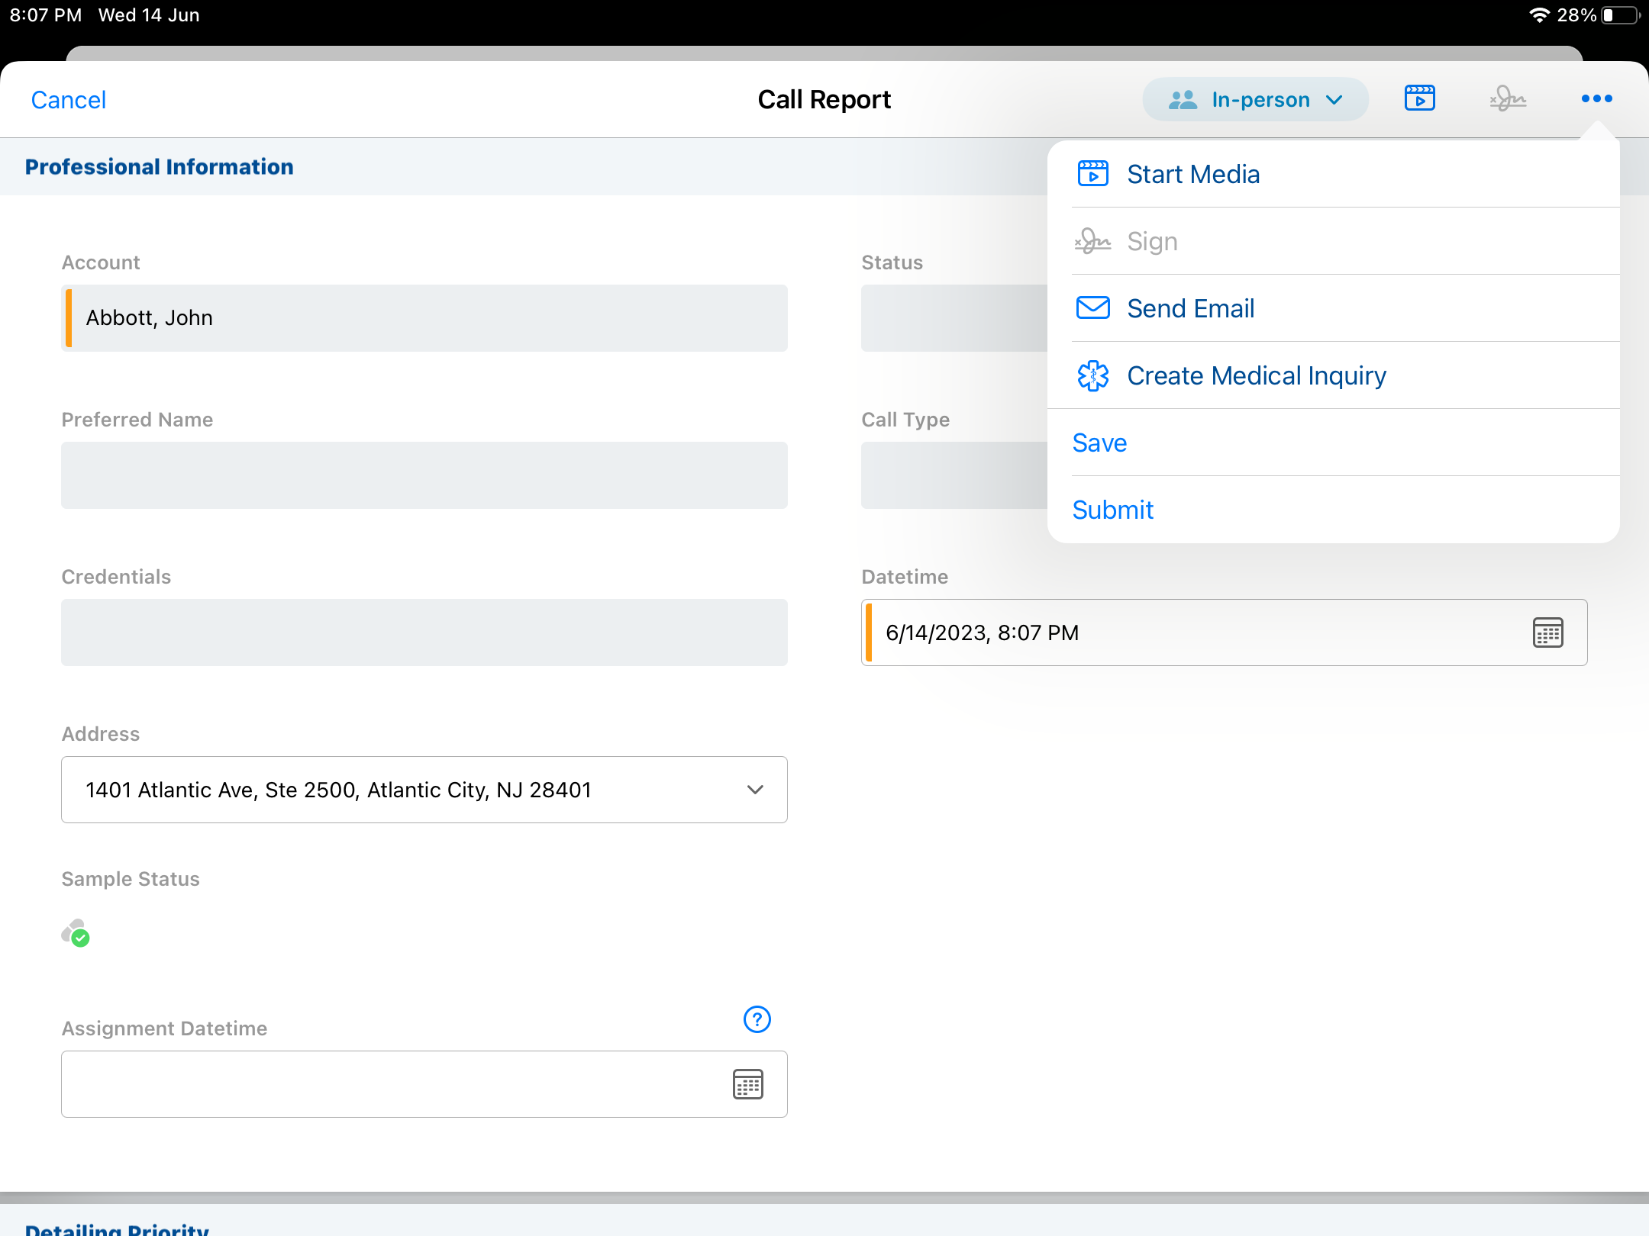
Recording Call
  Recording a call on iRep is quick and easy
  Calls can be initiated from several places
  - Ensures users are always a tap away from being able to record a call
  Supports customer facing actions such as displaying media and signature capture
  Ability to Save and Submit a call, configured using the call page layout online

Slide 20
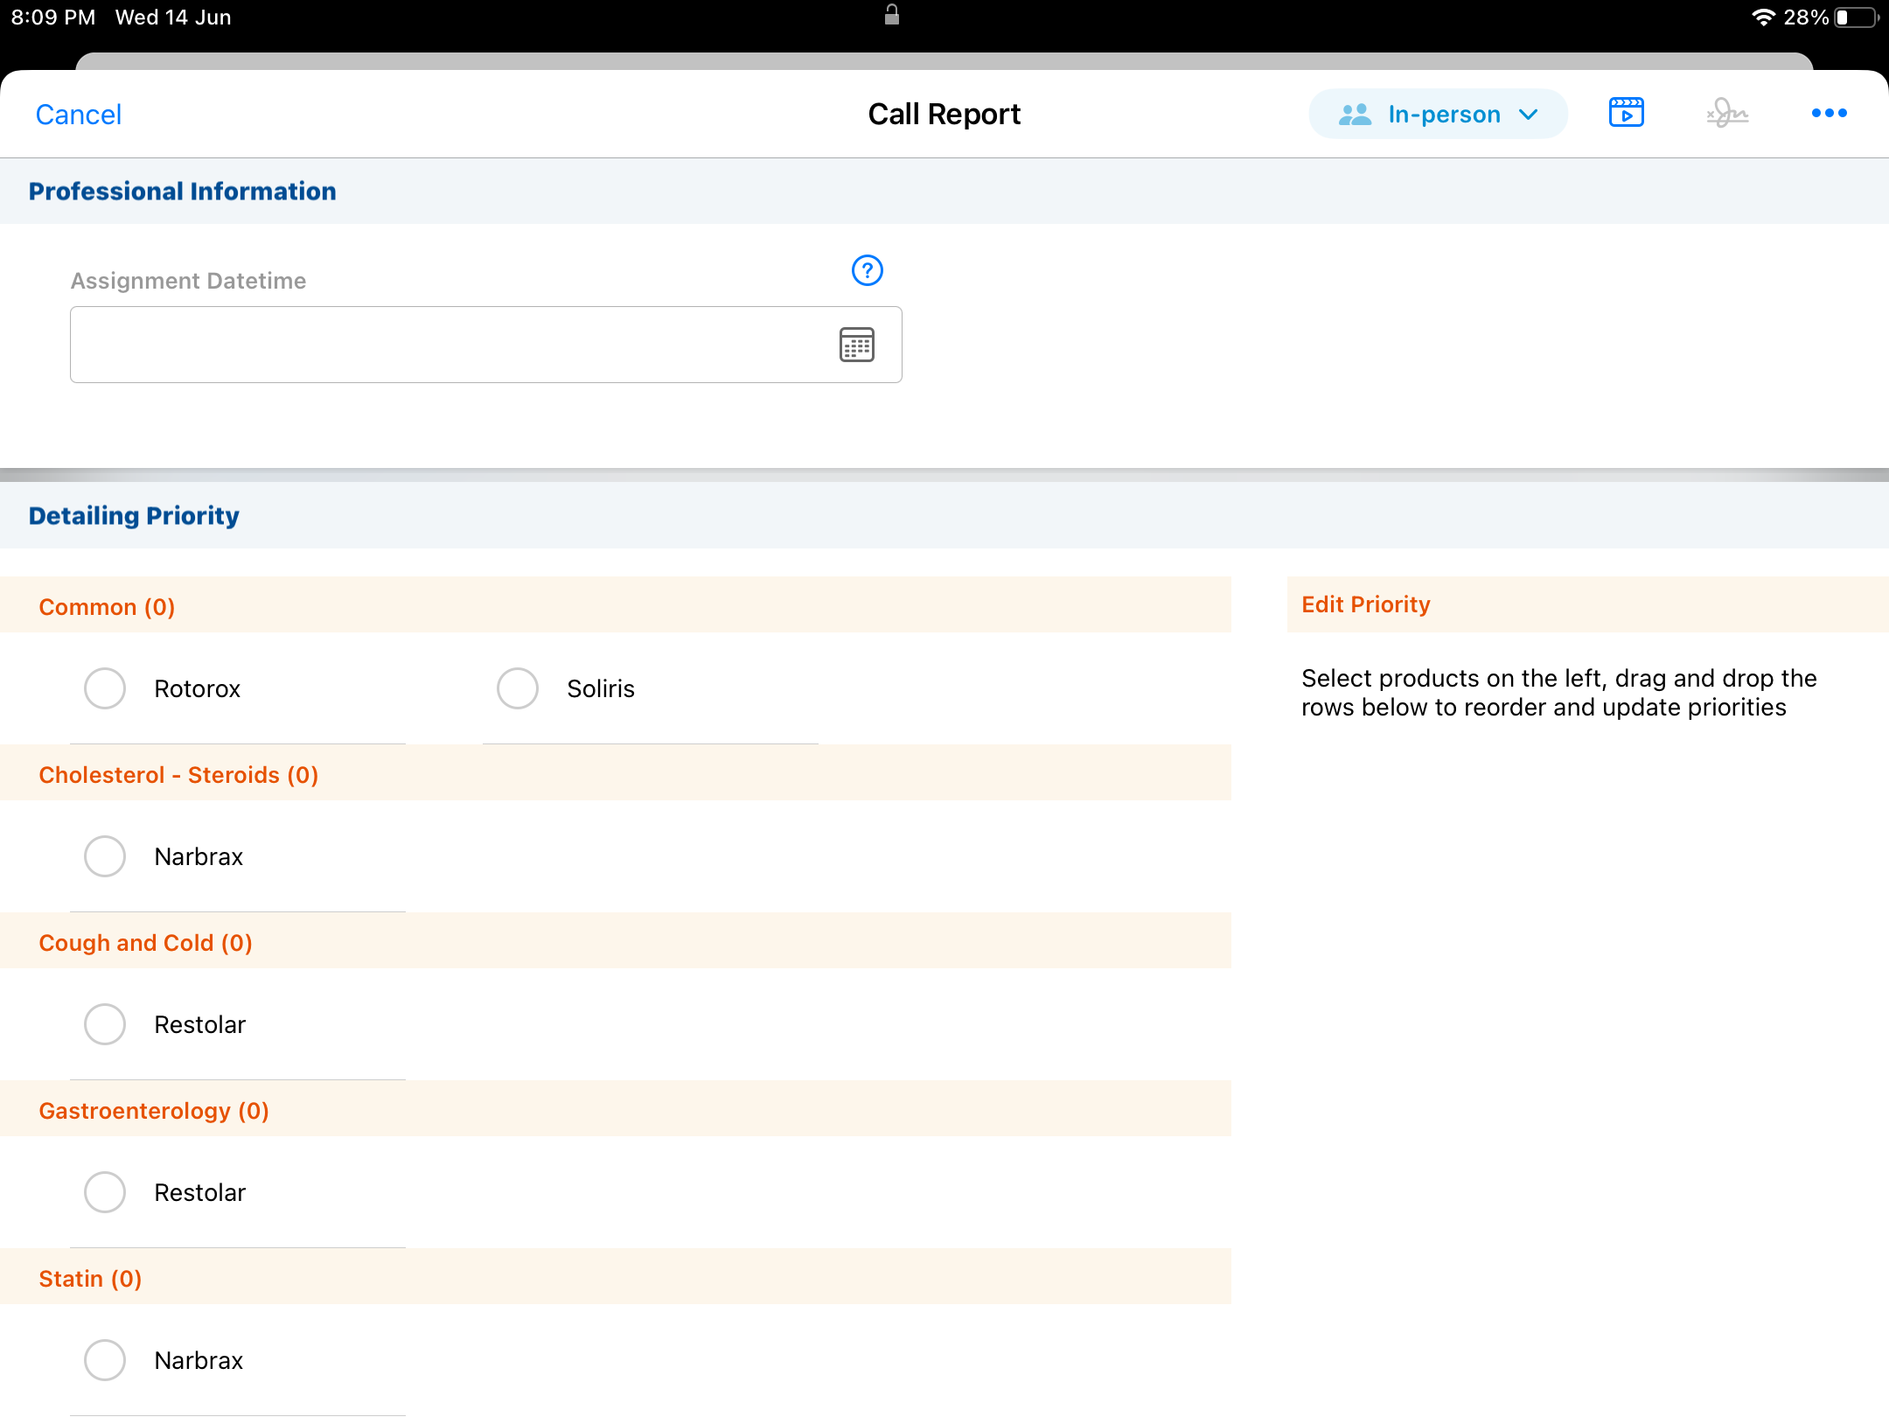
Recording Call - Attendees
  Allows users to identify who attended a group call
  - Account affiliations and Hierarchy drive list of available attendees
  Tap on the attendee name or the checkbox next to the name to select attendee
  - If a desired account is not listed, tap the Search button to open a search box
  Sample button appears if the attendee is sample eligible
  layout online

Slide 21
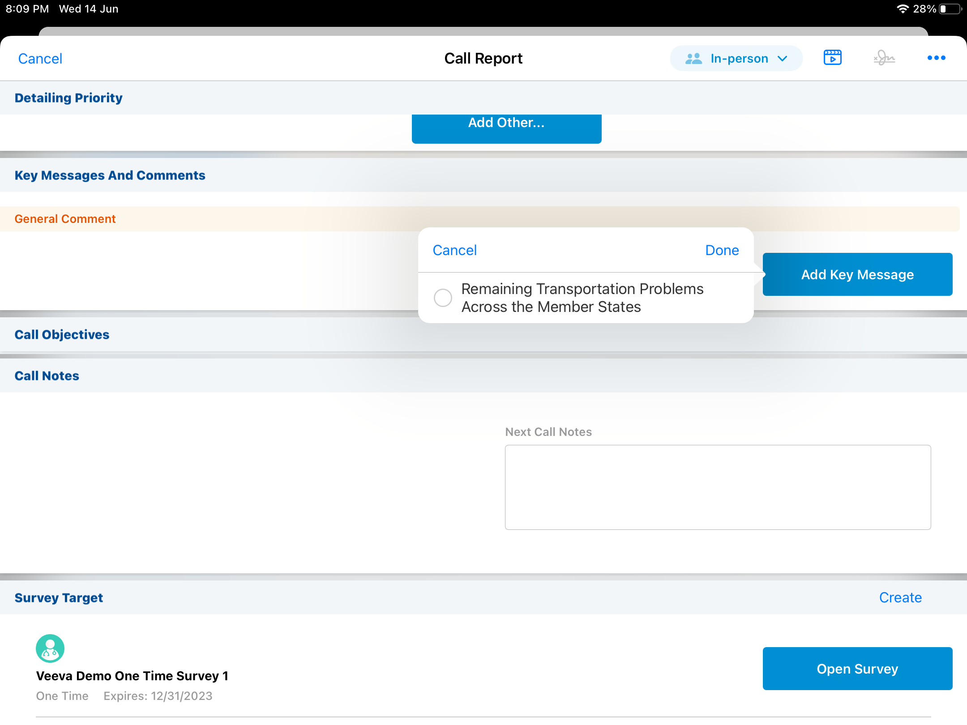
Recording Call –Product Priority
  Allows the user to specify the products discussed in the call and in which order they were detailed
  Available products are displayed on the right side
  Driven by the user’s My Setup product
  Tap a product to select it
  Order is based on the order the products are selected and can be reordered through drag and drop

Slide 22
Recording Call –Key Messages
  Allows the user identify the specific messages that were delivered for each product in the Product Priority control
  Each message has a Reaction field that allows the user to indicate the reaction to the message by the customer

Slide 23
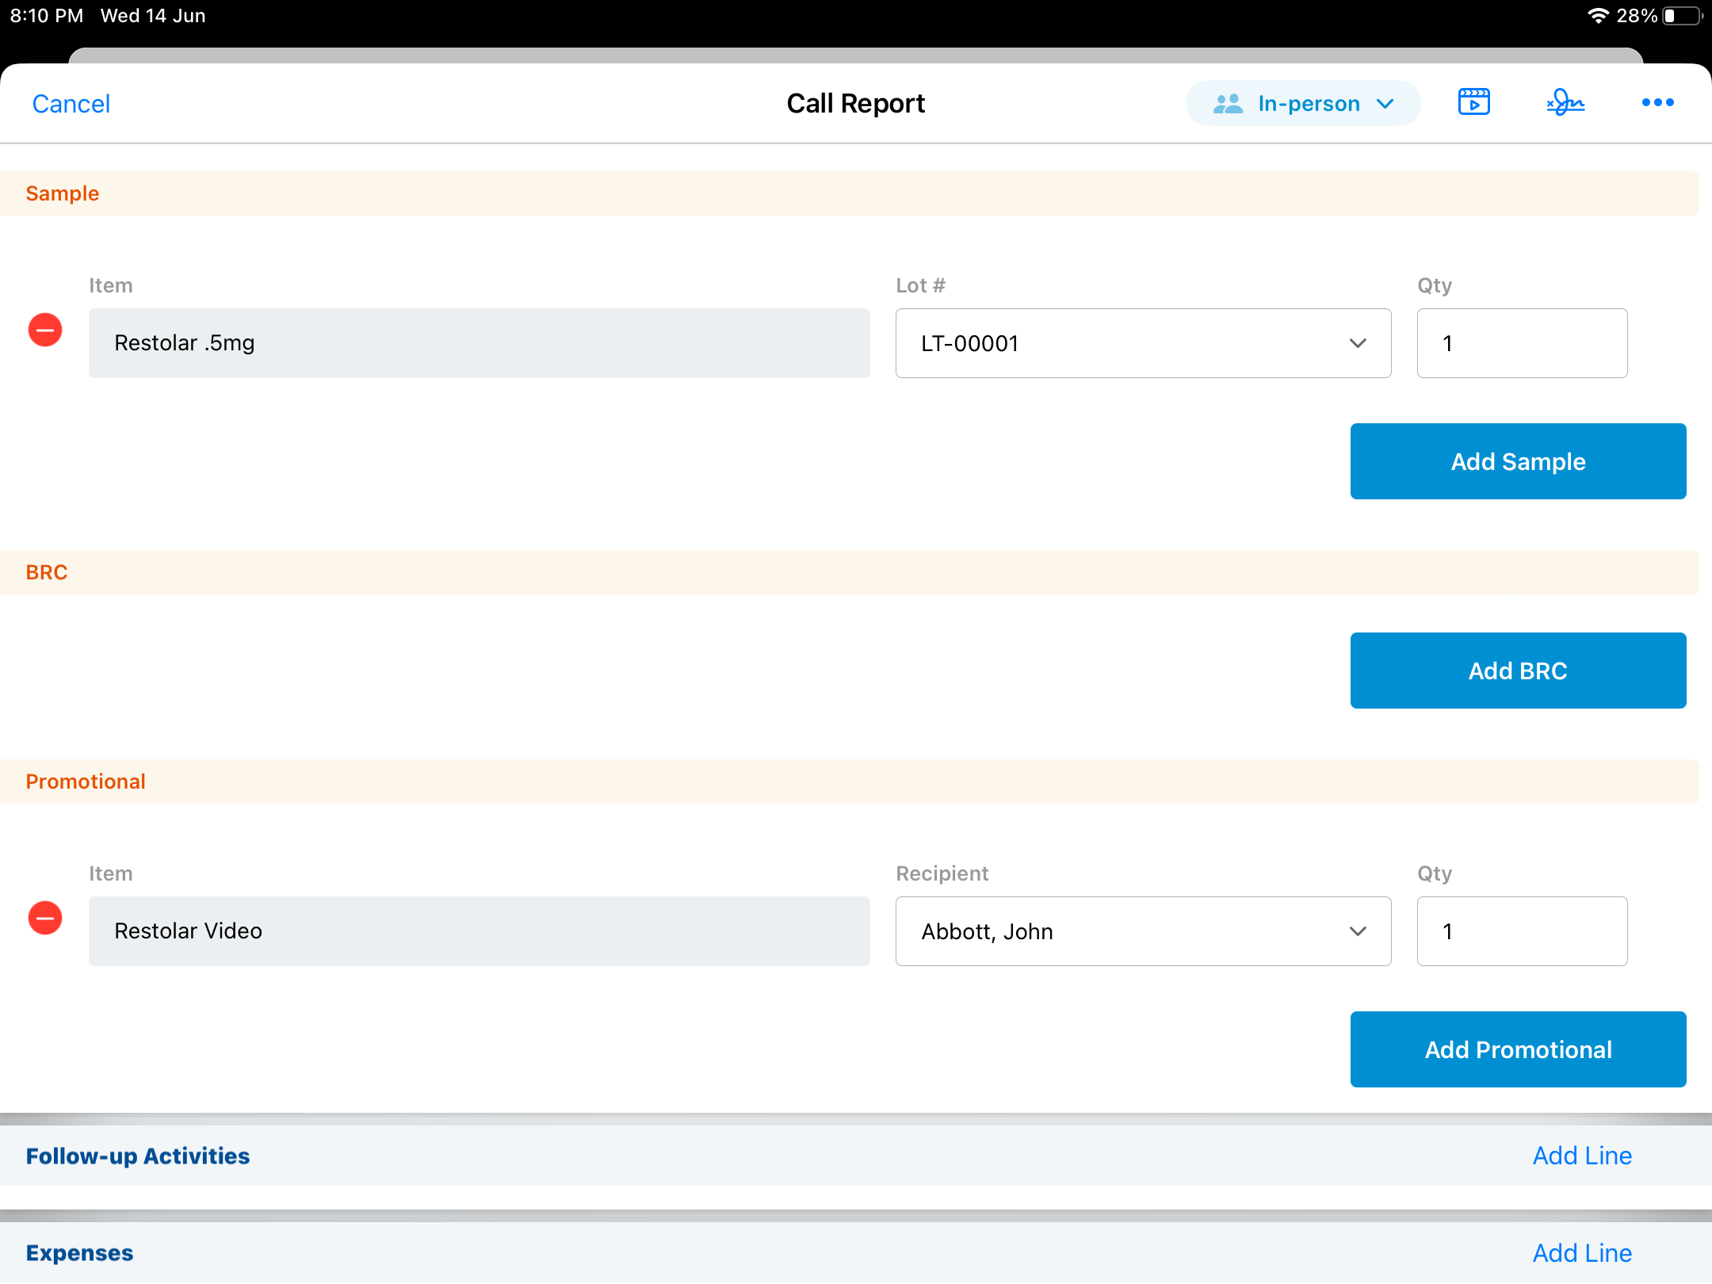
Recording Call – Sample and Promotional Items
  Enables users to select samples, promotional items, and other products
  iRep supports sample disbursements and sample send/BRC
  Controlled substance sampling is currently not supported in iRep

Slide 24
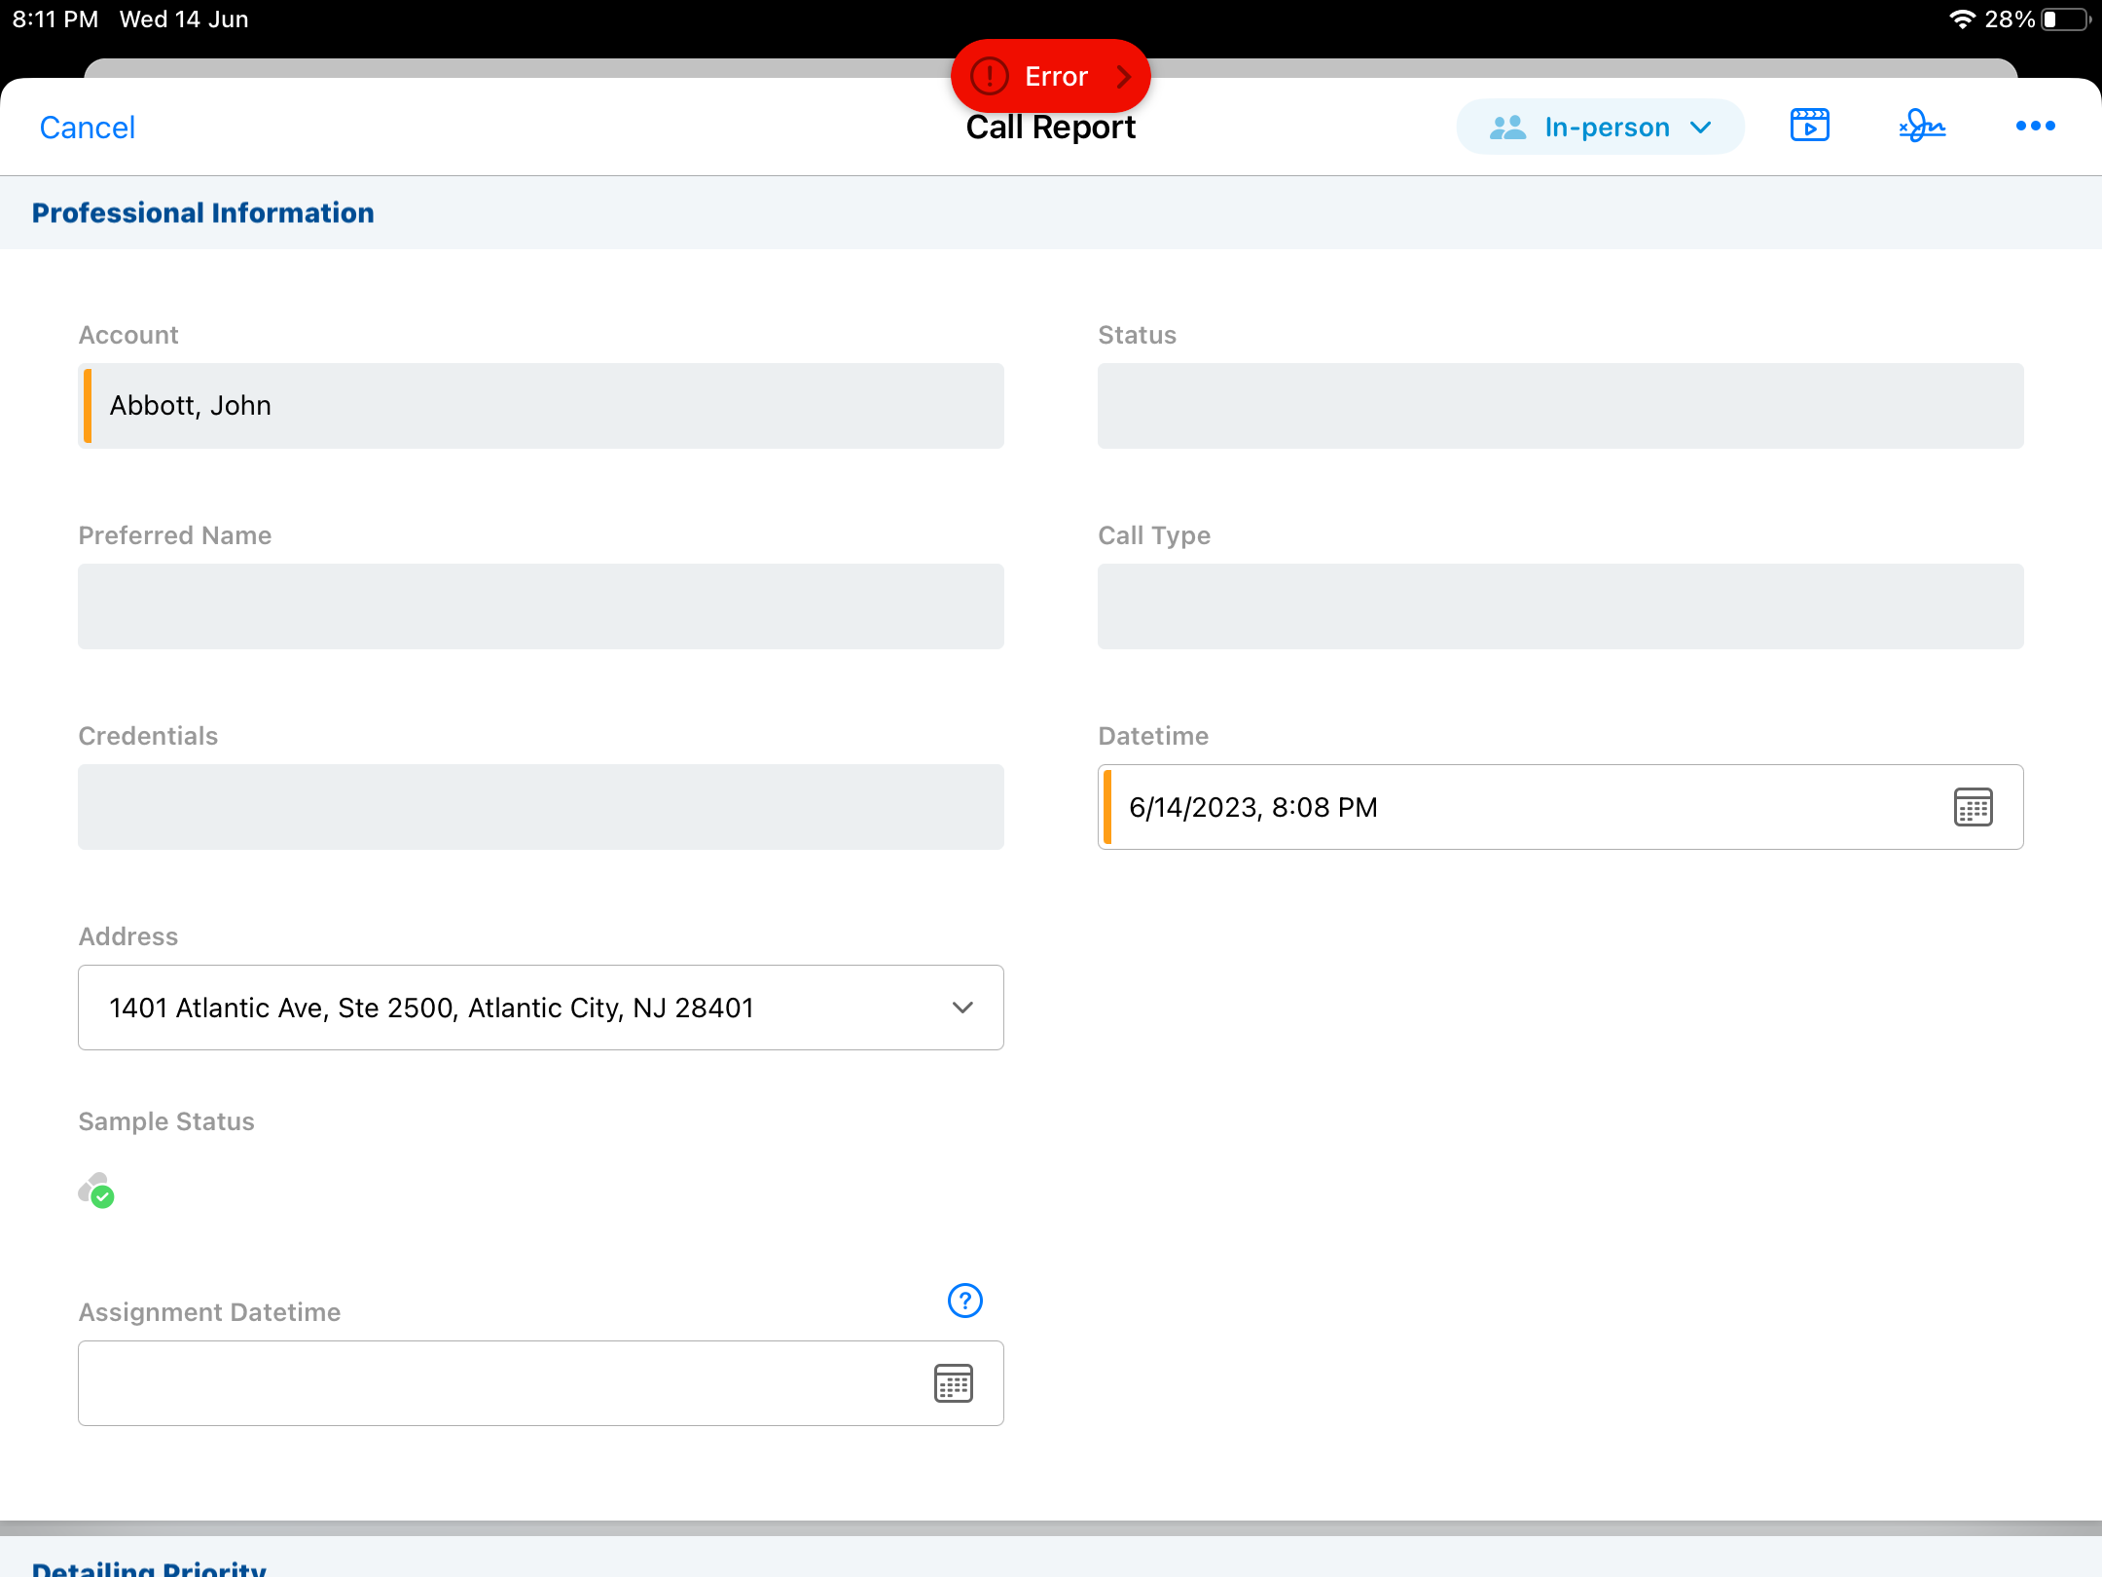
Managing iRep Errors
  An error icon appears in the toolbar when an error occurs during sample validation or submission of the call
  Badge shows the number of validation errors
  Tap error icon to display list of errors
  Tapping an error message will scroll automatically to the area that needs attention

Slide 25
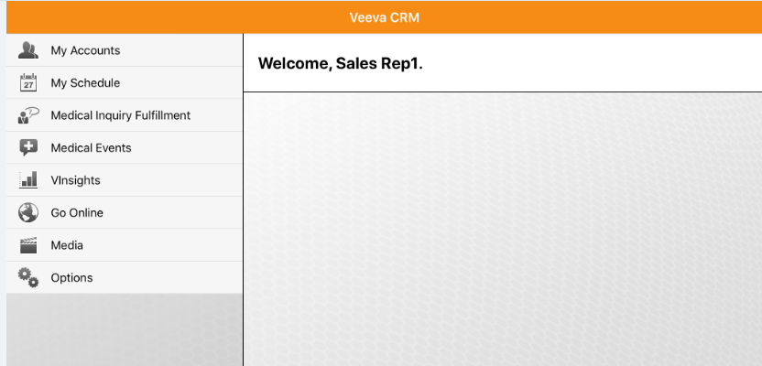
Vinsights Tab
  Tap the VInsights menu item to display VInsights online
  Requires internet connection
  Automatically logs user into Salesforce.com via the embedded browser

Slide 26
Go Online
  Tap the Go Online menu to navigate to VEEVA CRM Online in full screen embedded browser
  Use arrows to move through browser history
  Done button closes the browser
  URL is configurable

Slide 27
Synchronization
  Tap the Sync button in the bottom left corner to initiate sync
  Submitted calls are automatically synchronized to the server if iRep detects a network connection
  Only updates from the device to the server are synchronized, no additional data is retrieved
  Data and media are synchronized during the same process
  If new content is available at the time of synchronization it will be downloaded
  Sync can be performed over Wi-Fi or a 3G connection
  Can take several minutes over 3G based upon the amount of content being downloaded

Slide 28
iRep Configuration
IREP Configuration
20-07-2023

Slide 29
Home Page Installation Link
  The iRep Installation link can be displayed in the left sidebar for users
  Setup → Customize → Home → Home Page Layout
  Remove when no longer needed

Slide 30
iRep Configuration - VMOC
  VMobile Object Configuration object controls what objects and records are synced to offline platforms
  This data is entered on the VMOC tab. Users can create a VMOC with specific instructions using a WHERE clause
  For example, to limit the Calls synced to the last 90 days, the Where clause for the Call2 object would be: WHERE (Account_vod__r.Name !=null OR User_vod__r.Name !=null OR Medical_Event_vod__r.Name !=null OR Contact_vod__r.Name!=null) AND (Status_vod__c = 'Planned_vod' OR (Call_Date_vod__c ›= LAST_N_DAYS:90 and Call_Date_vod__c ‹= NEXT_N_DAYS:30))

Slide 31
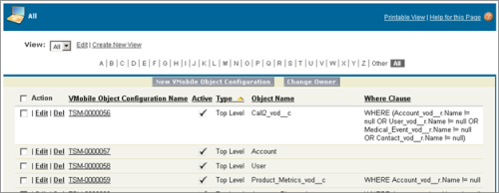
iRep Configuration – Objects and Data to be Synced 1
  The VMobile Object Configuration tab provides access to the sync options for VEEVA CRM Mobile users

Slide 32
iRep Configuration – Objects and Data to be Synced 1
  The settings in the Configuration tab control the processing behind the VEEVA CRM mobile synchronization process
  These object configurations allow customers to control visibility to data and its relationships across objects
  For instance, clinical trial information that is related to an account can be synced whereas related orders can be skipped
  For each object to be synchronized down to mobile platforms, a VMobile Object Configuration record must exist with the Active_vod__c field selected and the relevant value for Device_vod__c
  For CRM for iPad, the Device_vod__c value should be set to iPad_vod and for Windows 8, it should be set to WinModern_vod__c

Slide 33
iRep Configuration – Objects and Data to be Synced 2
  There are four types of VMobile Object Configurations:
  Full Sync
  Top Level
  Related to Top Level
  Child and Parent Row
  The where clause for the Child_Account_vod__c VMOC cannot be changed. This is primarily done for performance reasons and to support syncing down child accounts that point to accounts outside of the user's territory (from both the Parent_Account and Child_Account fields)
  The following criteria is always used for syncing down Child_Account_vod:
  WHERE Parent_Account_vod__c IN (SELECT Id from Account) or WHERE Child_Account_vod__c IN (SELECT Id from Account)

Slide 34
iRep Configuration
iRep CLM Overview
20-07-2023

Slide 35
CLM Overview
  The iRep Closed Loop Marketing (CLM) capabilities
  - Streamlines the process for managing and distributing digital content
  - Gives users easy access to the most current and relevant information
  Content viewer enables users to preview and deliver e-detail material and interactive presentations
  With CRM, users have the ability to capture physician reactions to content and messaging
  The responses are seamlessly synchronized to VBioPharma online for use in reporting and analysis that improves detailing quality
  Companies can deploy CLM only

Slide 36
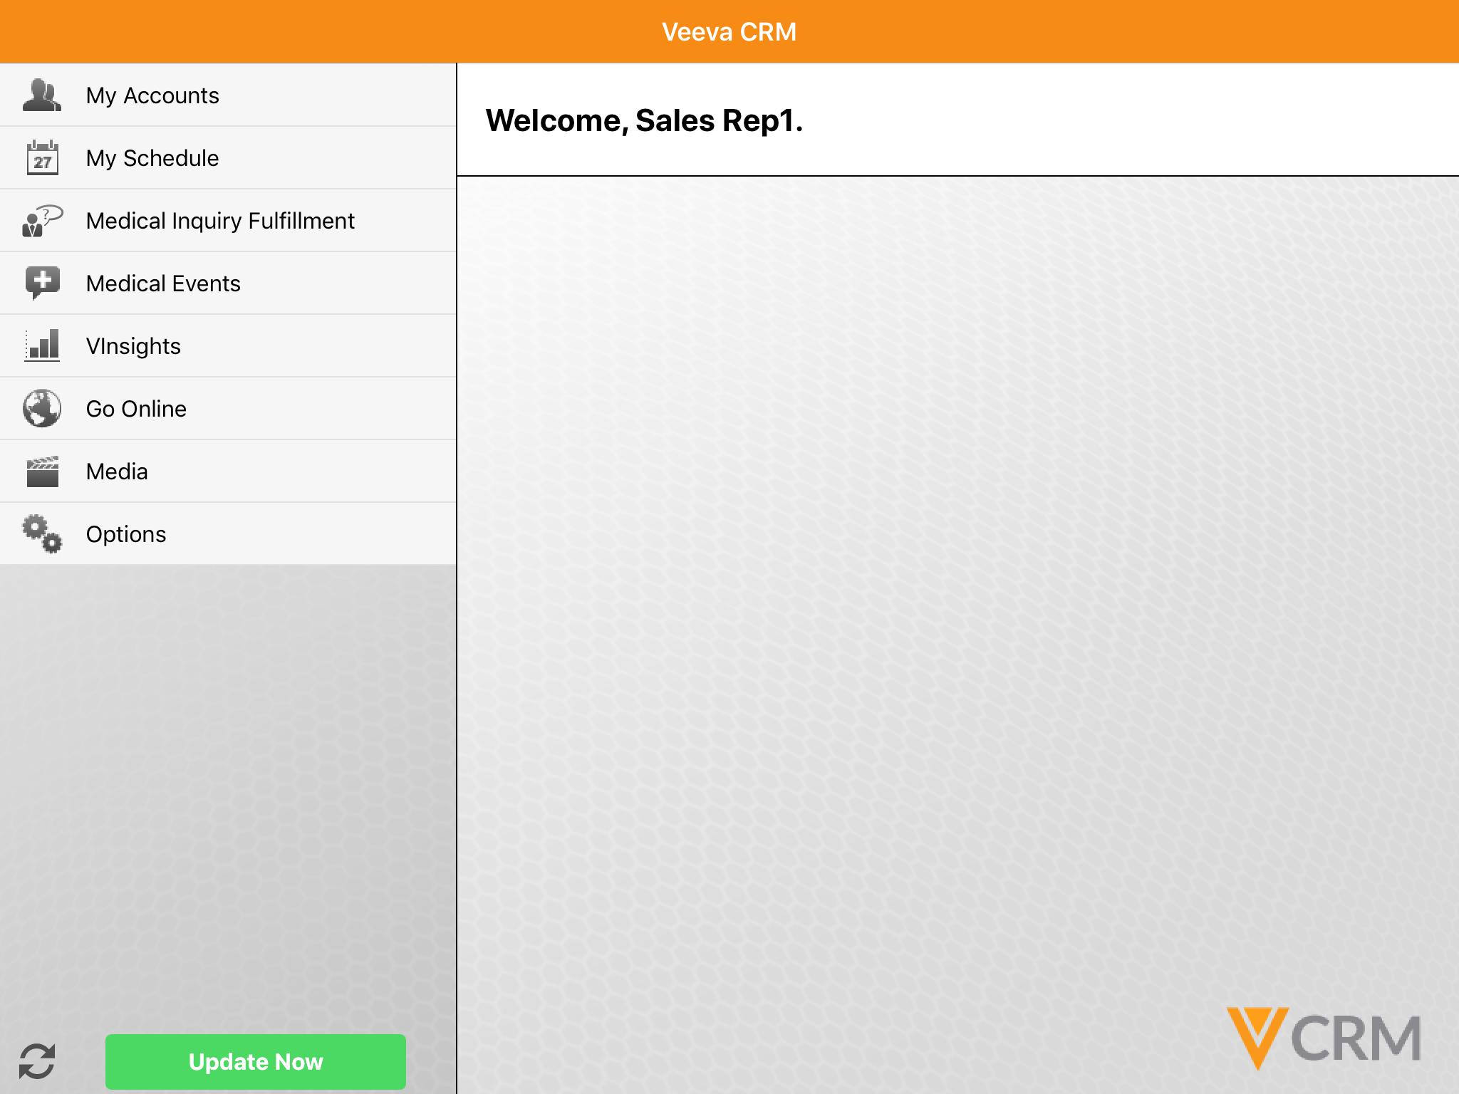
CLM Media Visibility
  The Media menu on iRep’s home page displays if user has at least read permission on:
  CLM_Presentation_vod
  CLM_Presentation_Slide_vod

Slide 37
Viewing CLM Content
  Users can view content in full screen
    Swipe left or right to move between content components
  Scroll the thumbnail view to jump to specific slides

Slide 38
Enabling CLM in Your Org
  Create a case with VEEVA Customer Support
    Note each production org or sandbox which needs to have access to media
    If a sandbox is refreshed, this access will need to be requested again and the content reloaded
  Configure profiles for the content loading user and viewing users
    Create/Read permission to Key Message, Presentation, and Presentation Slide objects
  Add at least one product to the content viewing user’s My Setup
    Media that specifies a product where the user does not have matching my setup products will not be downloaded or displayed for that user

Slide 39
Configuring Org for CLM 1
  Configure call page layouts to display eDetailing info
  Add a section with “zvod_CLMDetails” marker field
  Edit Key Message page layout Structured Comment Layout_vod
  Create a section called Media Information above the system information section
  Add Media File Visual Force Page
  Add related list CLM Presentation Slide

Slide 40
Configuring Org for CLM 2
Configure the page layout for CLM Presentation object
  Go into CLM Presentation object
  Edit the page layout CLM Presentation Layout
  Add the Presentation_ID_vod (an external ID)
  Add the related list CLM Presentation Slides
Configure the page layout for CLM Presentation Slide object
  Show at least CLM Presentation, Key Message, and Display Order
  Optionally, add a formula field “Key Message Product” on the CLM Presentation Slide Object, with value “Key_Message_vod__r.Product_vod__r.Name”
Clear the VEEVA Cache

Slide 41
Check Your Understanding ... 1
1.Select which of the following is correct with respect to Installing iRep
First Download VEEVA iRep link to install the application and then install Provisioning profile
iRep can store multiple user logins and databases
Provisioning profile needs to be installed each time a user log into iRep
iRep SQLite local database needs to be installed on the iPad
Answer: iRep can store multiple user logins and databases, iRep SQLite local database needs to be installed on the iPad

Slide 42
Check Your Understanding ... 2
2. How do we enable configuration of Object and Data Sync in iRep ?
Permission set
VMOC
Answer: VMOC

Slide 43
Check Your Understanding ... 3
3. Vinsight also works Offline iRep ?
True
False
Answer: False

Slide 44
Check Your Understanding ... 4
4. The Media menu on iRep’s home page displays if user has at least read permission on?
CLM_Presentation_vod
CLM_Presentation_Slide_vod
Both
Answer: Both

Slide 45

Summary
In this module, you have learnt to:
Define iRep
Install iRep
Navigate through iRep UI
Configure iRep
Define CLM and its capabilities & Configure CLM

Slide 46
Source
https://crmhelp.veeva.com/doc/Content/CRM_topics/Mobile_Device_Setup/Home_Screen.htm
https://crmhelp.veeva.com/doc/Content/CRM_topics/Multichannel/CLM/What_is_CLM.htm
Disclaimer: Parts of the content of this course is based on the materials available from the Web sites and books listed above. The materials that can be accessed from linked sites are not maintained by Cognizant Academy and we are not responsible for the contents thereof. All trademarks, service marks, and trade names in this course are the marks of the respective owner(s).

Slide 47
Coming Next ...
In the upcoming module – DCR Configuration, you will learn to,
  Define the Online & iPad DCR Process
  Configure a DCR
  Look at the output/results of a DCR
  Describe a DCR Model
  Describe the Network settings required for a DCR

Slide 48
Thank you
  You have successfully completed
  iRep Configuration Course

